Slide 1
Uva 10382
Watering Grass
Time: 3 seconds

Slide 2
Problem Descriptions
n sprinklers(灑水器) are installed in a horizontal strip of grass l meters long and w meters wide.
l
w

Slide 3
Problem Descriptions
Each sprinkler is installed at the horizontal center line of the strip.
For each sprinkler we are given its position as the distance from the left end of the center line and its radius of operation.
What is the minimum number of sprinklers to turn on in order to water the entire strip of grass?

Slide 4
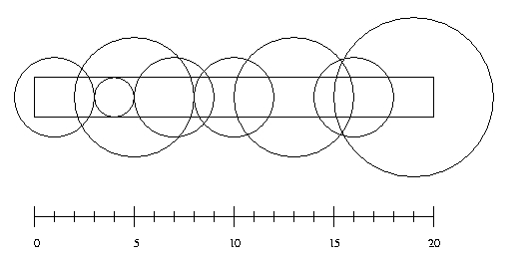
Problem Descriptions
l
w

Slide 5

Example
Input:
8 20 2 (8 sprinklers, l==20, w==2)
5 3 (position==5, radius==3)
4 1
1 2
7 2
10 2
13 3
16 2
19 4
Output:
6
7
10
13
16
19
1
4
5
3
10
2
2
2
3
1
2

Slide 6
Solution
7
10
13
16
19
1
4
5
3
10
2
2
2
3
1
2

Slide 7

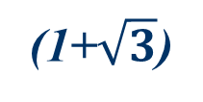
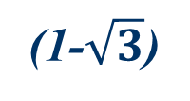
Solution
7
10
13
16
19
1
4
5
3
10
2
2
2
3
1
2
(x)
w/2=2/2=1
2
1
$$\sqrt{2^{2}−1^{2}}=\sqrt{3}$$
(1-$\sqrt{3}$)
(1+$\sqrt{3}$)

Slide 8
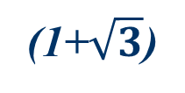
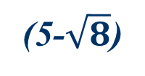
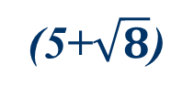
Solution
7
10
13
16
19
1
4
5
3
10
2
2
2
3
1
2
(4-1)
(4+1)
(0)
(1+$\sqrt{3}$)
(5-$\sqrt{8}$)
(5+$\sqrt{8}$)

Slide 9
Solution
7
10
13
16
19
1
4
5
3
10
2
2
2
3
1
2
A
B
C
D
E
F
G
H

Slide 10
Solution
A
B
C
D
E
F
G
H

Slide 11
Solution
A
B
C
D
E
F
G
H

Slide 12
Solution
A
B
C
D
E
F
G
H

Slide 13
Solution
A
B
C
D
E
F
G
H

Slide 14
Solution
A
B
C
D
E
F
G
H

Slide 15
Solution
A
B
C
D
E
F
G
H

Slide 16
Solution
A
B
C
D
E
F
G
H

Slide 17
Solution
A
B
C
D
E
F
G
H

Slide 18
Solution
Sort all intervals by start time
Choose an interval with the small start time
While selecting an interval, the greedy algorithm decides the next interval according to the farthest ending time.

Slide 19
Time Complexity
Sort: O(nlogn)
Scan: O(n)

